Slide 1
Introduction to PHP and Apache
Ivan Yonkov
Training Lead
Software University
www.softuni.bg
Setup and Basics Syntax

Slide 2
PHP

Slide 3
Server-Side Scripting
Notes:
Server-side scripting is a technique used in web development which involves employing scripts on a web server which produce a response customized for each user's (client's) request to the website. The alternative is for the web server itself to deliver a static web page. Scripts can be written in any of a number of server-side scripting languages that are available (see below). Server-side scripting is distinguished from client-side scripting where embedded scripts, such as JavaScript, are run client-side in a web browser, but both techniques are often used together.

Slide 4
Script
<?php for ($i = 0; $i < 10; $i++) { echo "On line {$i}" . PHP_EOL; }
Notes:
A simple script that declares a for loop with 10 iterations.
The script produces 10 string lines send to the standard output

Slide 5
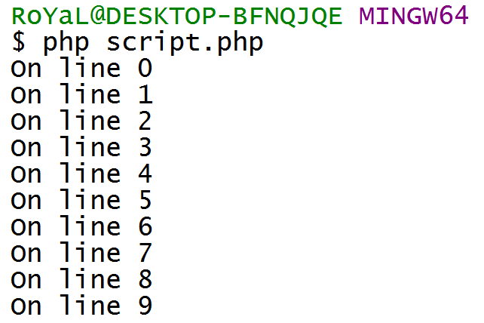
Script (2)
Notes:
PHP does not compile by nature. As oppose it is interpreted.
The interpreter parses the code and executes it at the same time.
In order to execute a PHP script, you do need to pass it to the PHP interpreter

Slide 6

Web Server
Notes:
Many generic web servers also support server-side scripting using Active Server Pages (ASP), PHP, or other scripting languages. This means that the behaviour of the web server can be scripted in separate files, while the actual server software remains unchanged. Usually, this function is used to generate HTML documents dynamically ("on-the-fly") as opposed to returning static documents. The former is primarily used for retrieving and/or modifying information from databases. The latter is typically much faster and more easily cached but cannot deliver dynamic content.

Slide 7



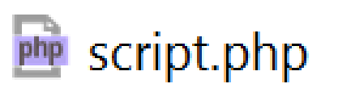
Web Server (2)
php.exe
OPENS http://site.bg/script.php
RUNS PHP
Process
INTERPRETS
script.php
RESPONDS
RESPONDS
Notes:
The basic architecture and a lifecycle from its beginning to nowadays is the following:
A client (web browser, smart phone app, etc…) initiates a request e.g. tried to open a physical file stored in remote server
The remote server listening on a public port is then triggered and informed that a certain client wants to get served a physical file
If the file is in the known extensions for the web server, a certain strategy is prepared
In particular, if the file is PHP, a PHP process is started with arguments given (the filename to be executed in this particular case)
The PHP process interprets the PHP file and then receives back the response similar to the console invocation before 3 slides
As the PHP process was not started by the console, its standard output is redirected to the web servers standard input
The Web Server then receives back the output (text) from the interpretation result
The Web Server sends the response over the network to the client
The Client receives the response (output from the php file that was executed)
The Client executes certain strategy e.g. if it’s a web browser, it renders the response as HTML (unless other headers are sent)

Slide 8
Apache HTTP Server
Installation & Configuration
Notes:
Apache HTTP Server (sometimes spoken only Apache) is the world’s most used web server. As of July 2016, Apache was estimated to serve 46.41% of all active websites and 43.18% of the top million websites.
Instead of implementing a single architecture, Apache provides a variety of MultiProcessing Modules (MPMs), which allow Apache to run in a process-based, hybrid (process and thread) or event-hybrid mode, to better match the demands of each particular infrastructure. This implies that the choice of correct MPM and the correct configuration is important. Where compromises in performance need to be made, the design of Apache is to reduce latency and increase throughput, relative to simply handling more requests, thus ensuring consistent and reliable processing of requests within reasonable time-frames.

Slide 9
Installation
Official Web Site
XAMPP Bundle
Notes:
One way to setup our environment is to download the Apache HTTP Server from its official site. Then download the PHP interpreter and configure Apache to run the interpreter, pointing the executable folder and the configuration file.
Another way is to download a whole bundle (WAMPServer, XAMPP, etc…) which has packaged Apache, PHP and MySQL already configured.

Slide 10
Hello World
<?php echo "<h1>Hello World!</h1>";
Notes:
(Exercise slide)

Slide 11
Basic PHP Syntax
Variables, Loops, Arrays, Functions

Slide 12
Variables
<?php $name = 'John'; // String $age = 24; // int $description = "My name is $name, $age years old"; // String interpolation $grades = []; // empty array $ageNextYear = $age + 1; // math expression $fullName = $name . " Smith"; // concatenation $sisterAge = "22"; $sumAge = $sisterAge + $age; // type inference
Notes:
PHP is weak-typed language, which means that types are known at runtime and are not explicitly set to a variable, rather they are taken from the value. As a result, operations can be done between different types, then a type inference occurs
http://php.net/manual/en/language.variables.basics.php
https://en.wikipedia.org/wiki/Type_inference

Slide 13
For Loop
<?php for ($i = 0; $i < 10; $i++) { echo "<p>Hi there</p>"; }

Slide 14
For Loop (2)
<?php $names = ['John', 'Ben', 'Wilma']; for ($i = 0; $i < count($names); $i++) { echo "<p>{$names[$i]}</p>"; }

Slide 15
While Loop
<?php $i = 0; while ($i++ < 5) { echo "<p>On row $i</p>"; }

Slide 16
While Loop (2)
<?php $i = 5; while ($i--) { echo "<p>On row $i</p>"; }
Notes:
The automatic type conversion has occurred here.
PHP threats as falsy all values that could be false somehow (empty string, 0, null, false…)

Slide 17
While Loop (3)
<?php $name = "John"; while ($name = substr($name, 0, -1)) { echo "<p>New name $name</p>"; }
Notes:
The result of the assignation operation is the value entered in the variable.
In some other languages, assignation is void. Which means Console.WriteLine(a = 5); will not produce 5 to the standard output, unlike in PHP. “echo $a = 5;” will return 5 on the stdout.
In this particular case the result of the assignation is the modified name (“Joh”, “Jo”, “J”, “”);
The last iteration assigns “” (empty string) to the $name variable and returns its value. The while loop checks this value and threats it as falsy (as said in the last slide, empty string is falsy) thus it exits.

Slide 18
For Each Loop
<?php $ages = [12, 16, 18, 13, 22, 14, 30]; foreach ($ages as $age) { echo "<p>Current age: $age</p>"; }

Slide 19
For Each Loop (2)
<?php $ages = [12, 16, 18, 13, 22, 14, 30]; foreach ($ages as $age) { $age = $age + 10; echo "<p>New age: $age</p>"; } echo "<p> Not modified:( {$ages[0]}</p>"; // 12
Notes:
For Each loop does make an internal copy of the array while iterating. The underlying strategy is complex and deviates from the standard in the version evolution of the language.
Check this amazing post by one of the PHP core developers (which is 22 years old at the time this slide is written!)

Slide 20
For Each Loop (3)
<?php $ages = [12, 16, 18, 13, 22, 14, 30]; foreach ($ages as &$age) { $age = $age + 10; echo "<p>New age: $age</p>"; } echo "<p> Modified ☺ {$ages[0]}</p>"; // 22
Notes:
Iterating by reference (&)

Slide 21
For Each Loop (4)
<?php $letterCount = [ 'Apple' => 5, 'TV' => 2, 'Keyboard' => 8 ]; foreach ($letterCount as $word => $count) { echo "<p>The word {$word} has {$count} letters in it</p>"; }

Slide 22
Functions
<?php function sum($a, $b) { return $a + $b; } echo sum(4, 6);

Slide 23
Functions – Type Hinting
<?php function sum(int $a, int $b) { return $a + $b; } echo sum(4, 6);
Notes:
As of PHP 7.0, the language supports native type hinting and strict mode (arguments from other types cannot be passed)

Slide 24
Functions – Type Hinting (2)
<?php function sum(int $a, int $b) : int { return $a + $b; } echo sum(4, 6);
Notes:
Also it supports type hinting for return types, not only for arguments

Slide 25
Delegates && Closures
<?php function doSmth(int $a, callable $delegate) : callable { return function(int $x) use($a, $delegate) : int { return $x + 5 + $delegate($a); }; }
Notes:
Functions can accept other functions (so called delegates, predicates or consumers) type hinted by “callable”.
They also can return another functions

Slide 26
Delegates && Closures (2)
// f(a) = a * 2 $double = function(int $a) { return $a * 2; }; // f(x) = x + 5 + f(a) // f(x) = x + 5 + a*2 $result = doSmth(4, $double); // f(x) = x + 5 + 4*2

Slide 27
Delegates && Closures (3)
echo $result(20); // f(20) = 20 + 5 + 4*2 = 33

Slide 28
Introduction to PHP && Apache - Summary
The Web Server takes output from scripts and serves to client
PHP is Weak-typed language, yet supports types and hinting
PHP can dynamically create HTML to be served

